Slide 1
Reading
Merit Badge
Troop 344 and 9344
Pemberville, OH

Slide 2
Reading Merit Badge Requirements
Do EACH of the following:
Take a tour of a library. Discuss with your counselor how the library is organized and what resources and/or services are offered in the library.
Learn how to search a library's card catalog or computerized catalog by author, title, and subject.
In a library, search the card catalog or computerized catalog for six books of four different types, such as poetry, fiction, nonfiction, and biographies.
With the assistance of your merit badge counselor or the librarian, see if you can locate on the shelves the six books you selected.

Slide 3
Reading Merit Badge Requirements
Do EACH of the following:
Identify a book you have enjoyed. Find out what other books the author has written.
Look at one or more "best books" lists. These can be based on year, subject, or even all time. Identify at least one book you would like to read.

Slide 4
Reading Merit Badge Requirements
Read four different types of books, such as poetry, fiction, nonfiction, or biographies. Do any ONE of the following for each book you have read:
Write a review of the book. Include what you liked/didn't like about the book. Include if you would recommend this book, and if so, who might enjoy reading it.
Watch a movie based on the book. What was the same between the book and movie? What was different? Which did you enjoy more? Discuss this with your merit badge counselor.
Give a "book talk" to your class, troop, or patrol.

Slide 5
Reading Merit Badge Requirements
Read a nonfiction book or magazine that teaches you how to do something like cooking, wood-building projects, video game design, science experiments, knot-tying, etc. With your counselor's and parent's or guardian's permission, complete a project from the book. Share your experience with your merit badge counselor. Reading a merit badge pamphlet will not count toward completing this requirement.
Read about the world around you from any two sources: books, magazines, newspapers, the internet (with your parent's or guardian's permission), field manuals, etc. Topics may include Scouting, sports, environmental problems, politics, social issues, current events, nature, religion, etc. Discuss what you have learned with your counselor.

Slide 6
Reading Merit Badge Requirements
With your counselor's and parent's or guardian's permission, choose ONE of the following activities and devote at least four hours of service to that activity. Discuss your participation with your counselor.
Read to a sick, blind, or homebound person in a hospital or in an extended-care facility.
Perform volunteer work at your school library or a public library.
Read stories to younger children, in a group or individually.
Organize a book swap in your troop, school, or place of worship.
Organize a book drive to collect books. Donate them to an organization in need.

Slide 7
Requirement 1
Do EACH of the following:
Take a tour of a library. Discuss with your counselor how the library is organized and what resources and/or services are offered in the library.
Learn how to search a library's card catalog or computerized catalog by author, title, and subject.
In a library, search the card catalog or computerized catalog for six books of four different types, such as poetry, fiction, nonfiction, and biographies.
With the assistance of your merit badge counselor or the librarian, see if you can locate on the shelves the six books you selected.

Slide 8
1a. Library Organization
Libraries use classification systems to organize the books on the shelves.
A classification system uses letters and/or numbers (call numbers) to arrange the books so that books on the same topic are together.
This arrangement results in "serendipitous browsing:" you find one book in the catalog, go to the shelf, and, an even better book is sitting right next to it.
Libraries in the United States generally use either the Library of Congress Classification System (LC) or the Dewey Decimal Classification System to organize their books.
Most academic libraries use LC, and most public libraries and K-12 school libraries use Dewey.

Slide 9
1a. Library Organization
The Dewey Decimal System (DDC)
How to read call numbers in a public library
DDC works well in smaller libraries, but it isn't specific enough for large, diverse collections.
Tips for finding books using Dewey Decimal call numbers:
The number before the decimal point is always treated as a whole number.
The numbers following the decimal point are treated as decimals.
If another letter appears after the decimal number, it is also arranged first by letter and then by decimal number.
DDC has ten major classes
000 | Generalities
100 | Philosophy/Psychology
200 | Religion
300 | Social Sciences
400 | Language
500 | Natural Sciences/Mathematics
600 | Technology
700 | The Arts
800 | Literature/Rhetoric
900 | Geography/History

Slide 10
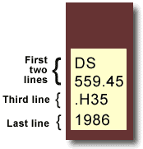
1a. Library Organization
Anatomy of a Library of Congress Call Number
Book title: Uncensored War: The Media and Vietnam Author: Daniel C. Hallin Call Number: DS559.46 .H35 1986
The first two lines describe the subject of the book. DS559.45 = Vietnamese Conflict
The third line often represents the author's last name. H = Hallin
The last line represents the date of publication.

Slide 11
1a. Library Organization
Listed below are the letters and titles of the main classes of the Library of Congress Classification. The system divides all knowledge into twenty-one basic classes, each identified by a single letter of the alphabet.
A - GENERAL WORKS
B - PHILOSOPHY. PSYCHOLOGY. RELIGION
C - AUXILIARY SCIENCES OF HISTORY
D - WORLD HISTORY AND HISTORY OF EUROPE, ASIA, AFRICA, AUSTRALIA, NEW ZEALAND, ETC.
E - HISTORY OF THE AMERICAS
F - HISTORY OF THE AMERICAS
G - GEOGRAPHY. ANTHROPOLOGY. RECREATION
H - SOCIAL SCIENCES
J - POLITICAL SCIENCE
K - LAW
L - EDUCATION
M - MUSIC AND BOOKS ON MUSIC
N - FINE ARTS
P - LANGUAGE AND LITERATURE
Q - SCIENCE
R - MEDICINE
S - AGRICULTURE
T - TECHNOLOGY
U - MILITARY SCIENCE
V - NAVAL SCIENCE
Z - BIBLIOGRAPHY. LIBRARY SCIENCE. INFORMATION RESOURCES (GENERAL)

Slide 12
1a. Library Resources and Services
Services Many Libraries Offer
Databases and subscriptions - Pick a topic, there's probably a database with the answer somewhere on it, and your library most likely has access to it.
E-books, e-mags, and audiobooks
Music, TV, and movie streaming
Computer and printer access
Language tools – Language learning apps.
Accessibility tools - Programs for people with low vision, blindness, or a physical disability that prevents them from holding a book.
College prep, job prep, and tutoring
Cultural events, programs, and classes - FREE programs that take place daily: writing workshops, author visits, career counseling, movie screenings, children programming, gaming night, health resources, teen leadership opportunities...so many more!

Slide 13
1a. Library Resources and Services
Services Many Libraries Offer
Archiving and digitizing - Services where you can learn how to preserve a digital archive so you won't lose all your personal information, and usually also have free equipment you can use to digitize VHS, audiocassettes, and scan old family photos and documents.
Library of Things - Most county libraries are building their own collections that may include karaoke machines, acoustic guitars, keyboards, food dehydrators, telescopes to see the beautiful stars, cotton candy machines, popcorn makers, kits to measure the wattage used in one's home... so many more!
"My Library Rewards“ - If your library has it, mylibraryrewards.com. Everything you check out in house, you get points for, then you redeem them for local coupons.
Books - Finding that next read.
The librarians themselves! - Librarians can help you find the answers to really bizarre questions without judgment.
And if you're interested in something that your library doesn't have, ask for it — and then use it.

Slide 14
1b. Card Catalog/Computerized Catalog
What the Library Catalog contains: Records for both print and online books, journals, newspapers, conference proceedings, sound recordings and scores, videos, archival collections, databases, maps, and more.
Basic Search: The search is a general keyword search with all words entered needing to appear in the record for it to show in the search results. Some things you can limit your keyword search to:
Title
Author
Subject
Call Number
Advanced Search: Using the dropdown in each row, select how the terms in the search box are related to each other for the search you want to do.

Slide 15
1b. Card Catalog/Computerized Catalog
Wood County District Public Library Catalog

Slide 16
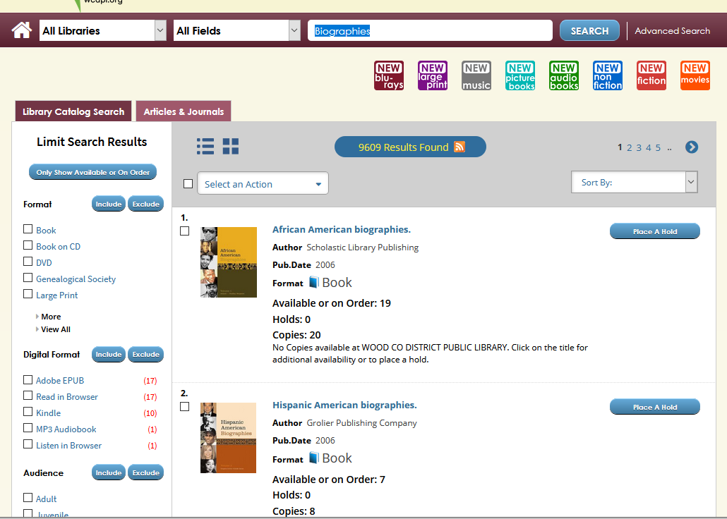
1c. Search the Library Catalog
In a library, search the card catalog or computerized catalog for six books of four different types, such as poetry, fiction, nonfiction, and biographies.

Slide 17
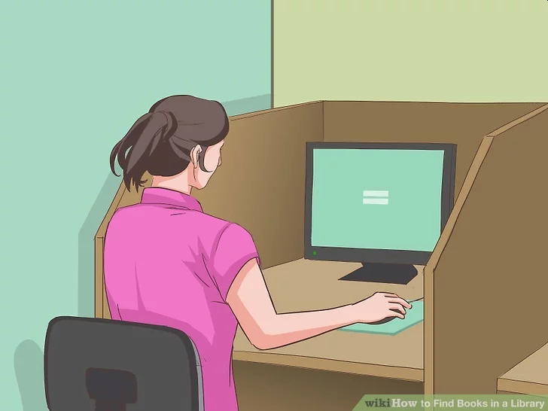
1d. Locating Books on the Shelves
Find a computer in the library. Today, most libraries have electronic catalogues available on computer terminals throughout the library. Find a computer and access the library's homepage. On the homepage there should be a search option for books, articles, magazines, newspapers and editorials. It is usually located at the top of the web page.

Slide 18
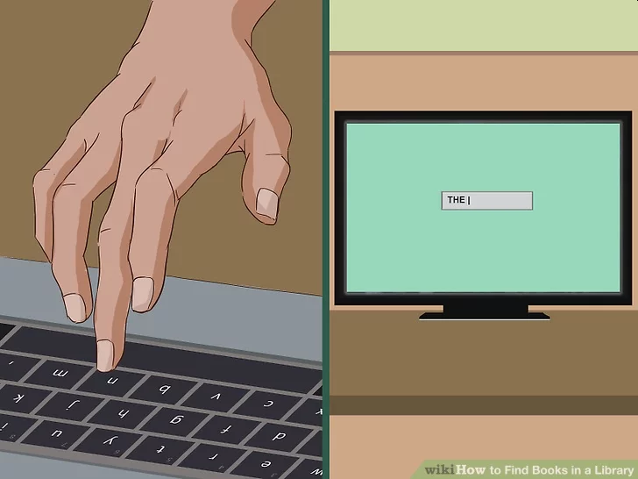
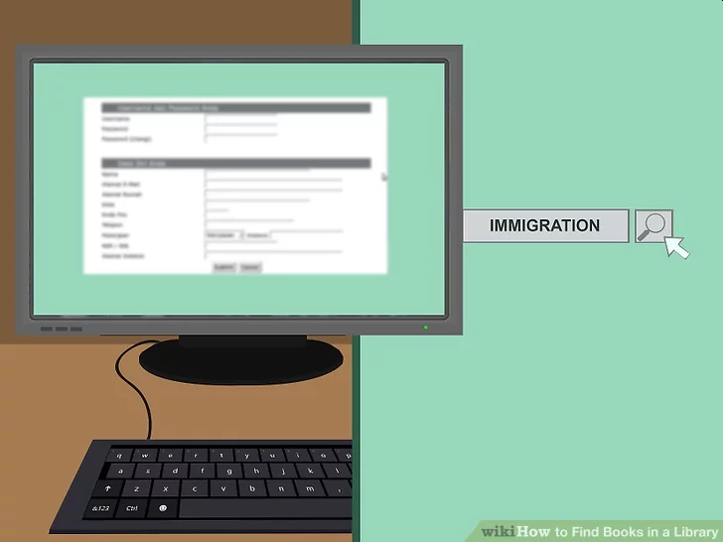
1d. Locating Books on the Shelves
Do a search using the computer catalog. Once you have found a book, click on the book's title. You will be redirected to a new page that contains specific information about your book, like the book's status and where it is located.

Slide 19
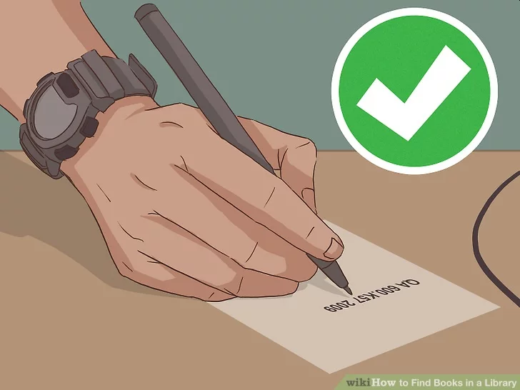
1d. Locating Books on the Shelves
Write down the book's location, call number and status. These are the three most important pieces of information that you need to write down. This information tells you where the book is located in the library and if it is available.

Slide 20
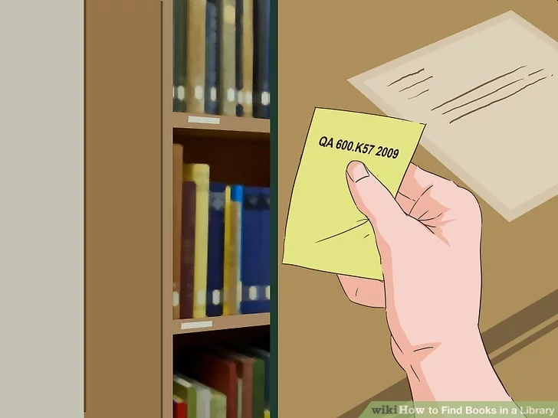
1d. Locating Books on the Shelves
Use the call number guide. Do this if your book is available (not checked out or missing). Identify the first two letters of the call number. Then find them on the guide. The guide will tell you which wing of the library the book is in and on what floor. For example, a book starting with QA may be in the blue wing on the fourth floor.
Look for call number guides around the computers, or at the library's main desk.

Slide 21
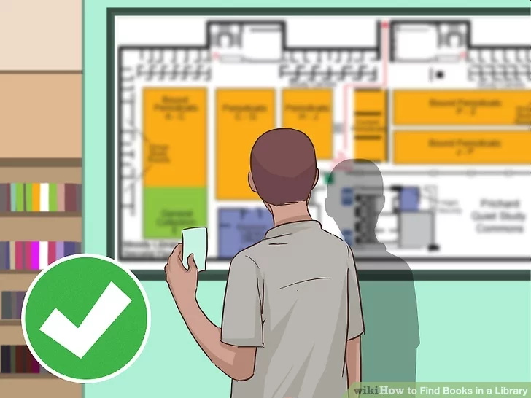
1d. Locating Books on the Shelves
Look at the library's map. Do this if you are unsure where the blue wing is, for example. You can find maps at the main desk of the library. The map will outline how to get to the different wings of the library, using the main desk as the reference point. Alternatively, you can ask a staff member to direct you to the wing.

Slide 22
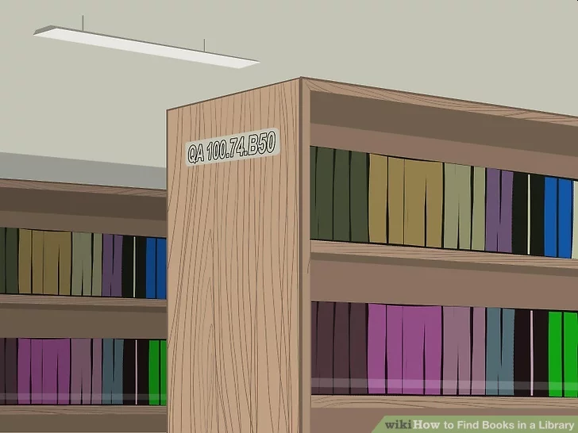
1d. Locating Books on the Shelves
Look at the labels at the end of the bookshelf. The bookshelf labels are organized alphabetically. Use these labels to locate which bookshelf your book is on. The labels typically contain a range of letters and numbers, for example, QA 100.74.B50 to QA 300.70.A30. If your book's call number falls within the range, then begin looking through that bookshelf.

Slide 23
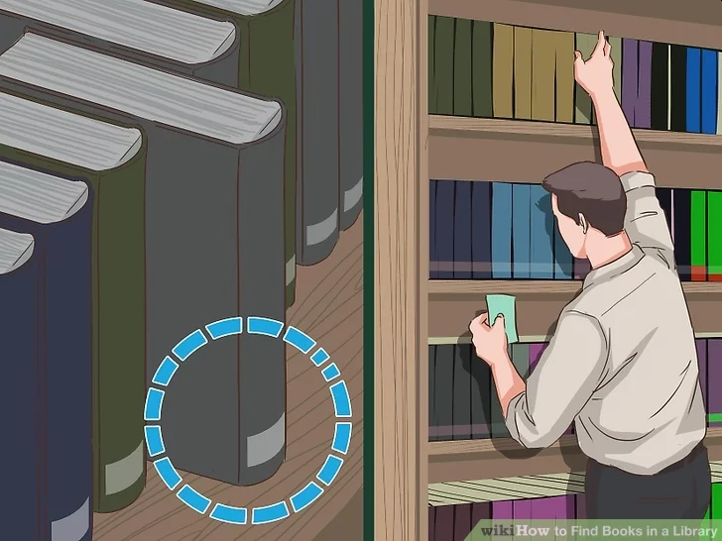
1d. Locating Books on the Shelves
Look at the numbers on the books' spine. The books are also organized alphabetically, so use the call number to locate the book. The call number is typically located at the bottom of the book's spine. The book's call number should match the call number in the system identically. Since books are organized by topic using the Library of Congress Classification System, try browsing the other books in the section you found your book in if you want more books on your topic.

Slide 24
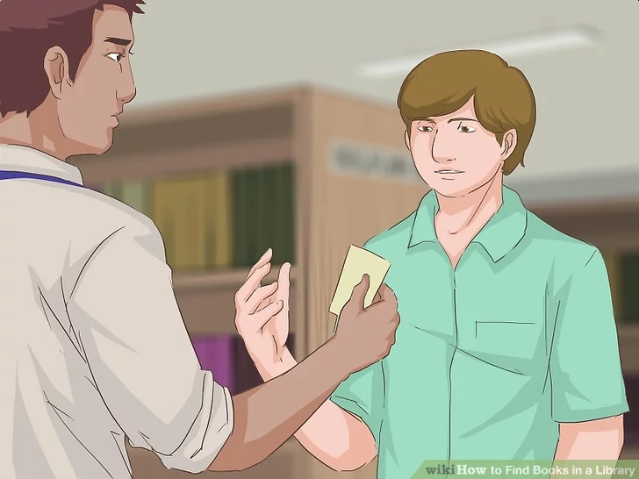
1d. Locating Books on the Shelves
Ask a staff member. Do this if you cannot find the book, but the system says it is available. The book may be misplaced, or perhaps you are looking in the wrong place. After all, most libraries are huge and it is easy to get confused. The staff member will go and look for the book for you.

Slide 25
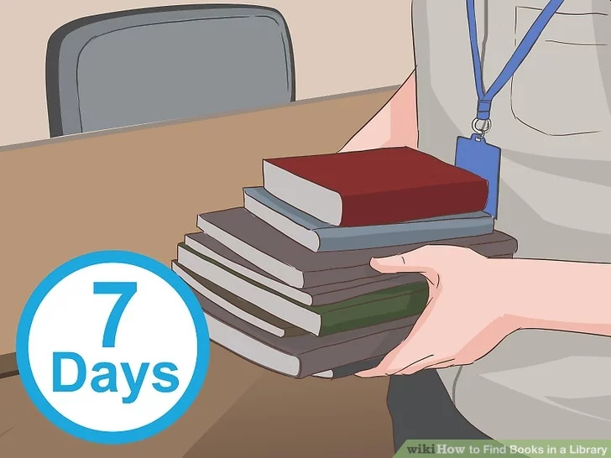
1d. Locating Books on the Shelves
Request an interlibrary loan. If the librarian confirms that the book is missing or unavailable, then request an interlibrary loan. You or the librarian will need to fill out a request form detailing the name of the book, author and year it was published, as well as your contact information. It usually takes five to seven days for a book to arrive. An interlibrary loan allows you to check out a book from another library where the book is available.

Slide 26
Requirement 2
Do EACH of the following:
Identify a book you have enjoyed. Find out what other books the author has written.
Look at one or more "best books" lists. These can be based on year, subject, or even all time. Identify at least one book you would like to read.

Slide 27
2a. Locating Books by Authors
When you find that perfect book, you might like to explore the author's other work, to see if he or she wrote more books you would like to read.
Begin by doing an Author search using the library catalog.

Slide 28
2a. Locating Books by Authors
Click the title of the book by the author that interests you.

Slide 29
2a. Locating Books by Authors
Use the information provided to locate the book in the library. If your library does not have it, you can borrow it from another library.

Slide 30
2b. Best Books Lists
Look at one or more "best books" lists. These can be based on year, subject, or even all time. Identify at least one book you would like to read.

Slide 31
2b. Best Books Lists

Slide 32
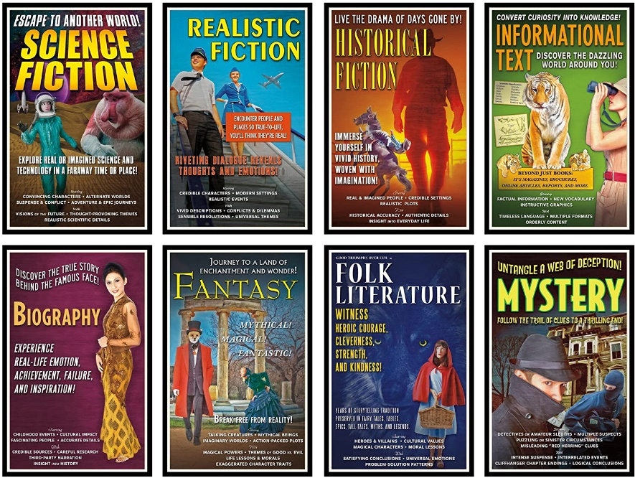
Requirement 3
Read four different types of books, such as poetry, fiction, nonfiction, or biographies. Do any ONE of the following for each book you have read:
Write a review of the book. Include what you liked/didn't like about the book. Include if you would recommend this book, and if so, who might enjoy reading it.
Watch a movie based on the book. What was the same between the book and movie? What was different? Which did you enjoy more? Discuss this with your merit badge counselor.
Give a "book talk" to your class, troop, or patrol.

Slide 33
Book Genres
Fiction Genres
Fantasy — The fantasy genre involves world-building and characters who are supernatural, mythological, magical, or a combination of these.
Science Fiction — Similar to fantasy, this genre explores futuristic or technological themes and ideas to address scientific “what if” questions.
Dystopian — Sometimes considered a subgenre of fantasy or of science fiction, this genre is usually set in a bleak future (near or distant) to explore cultural or social issues.
Adventure — Any novel that focuses on an adventure undertaken by the main character (with or without help) falls under the adventure genre. This genre can easily be combined with others.
Romance — Any novel where the main storyline centers on a romantic relationship falls into this category, which has several subgenres.

Slide 34
Book Genres
Fiction Genres
Detective & Mystery — One of the toughest genres to write, this one centers on a mystery and involves either a professional or amateur sleuth.
Horror — The goal of this genre is to scare your readers and keep them that way until the hero vanquishes the threat.
Thriller — This genre also has scary elements, but its main objective is to keep your reader in a state of suspense until the story’s resolution.
Historical Fiction — This genre covers fiction set in a specific time period and providing historically accurate detail relevant to the period and its characters.
Young Adult (YA) — This is fiction for readers aged 13 to 17 years.
Children’s Fiction — Fiction in this genre is written for kids aged up to 13 and is further divided into smaller subgenres.

Slide 35
Book Genres
Nonfiction Genres
Memoir & Autobiography — Each of the books in this genre is a true account of the author’s own life. Memoirs are typically related to a specific time in the author’s life or to a specific theme of the author’s choosing.
Biography — Biographies are books written on someone other than the author — generally someone well known or someone whose life and or death can teach the world something worth learning.
Cooking — In this genre, you’ll find books on every kind of cooking someone in the world took the time to write about, as well as cooking for different diets and nutritional needs.
Art & Photography — This genre includes books on artists of all kinds, as well as on each type of art and its history.
Self-Help / Personal Development — This genre is all about helping the reader realize their potential, develop their gifts, and live fulfilling lives.

Slide 36
Book Genres
Nonfiction Genres
Motivational / Inspirational — This genre’s main purpose is to get you to do something, to inspire you, or to challenge your perspective.
Health & Fitness — Here you’ll find books on both mental and physical health concerns as well as diets and weight loss.
History — This genre focuses on a specific time period or covers a broad span of time, often describing specific historical characters.
Crafts, Hobbies & Home — Look to this genre for topics related to creating a home and developing specific hobbies or crafts.
Families & Relationships — If it deals with family life, marriage, or any kind of interpersonal relationship, your book belongs in this genre.
Humor & Entertainment — Books in this genre are supposed to make you laugh or at least keep you entertained. Many also belong to the memoir genre.

Slide 37
Book Genres
Nonfiction Genres
Business & Money — If you’re writing a nonfiction book on business topics, wealth building, or managing your money, it probably belongs to this genre.
Law & Criminology — Books on the legal system, on laws, criminal justice, and related topics belong in this genre.
Politics & Social Sciences — Books in this genre discuss politics or issues related to one or more of the social sciences (psychology, sociology, social work, etc.).
Religion & Spirituality — From personal guides to spiritual memoirs to histories, this genre covers religions of all kinds along with spiritual practices.
Education & Teaching — Any book that proposes to teach the reader how to do something — or how to do it better — belongs to this genre.
Travel — This genre includes travel guides and travel-heavy memoirs.
True Crime — These often read like well-crafted crime fiction but are true stories that chronicle real crimes, typically with exacting detail.

Slide 38
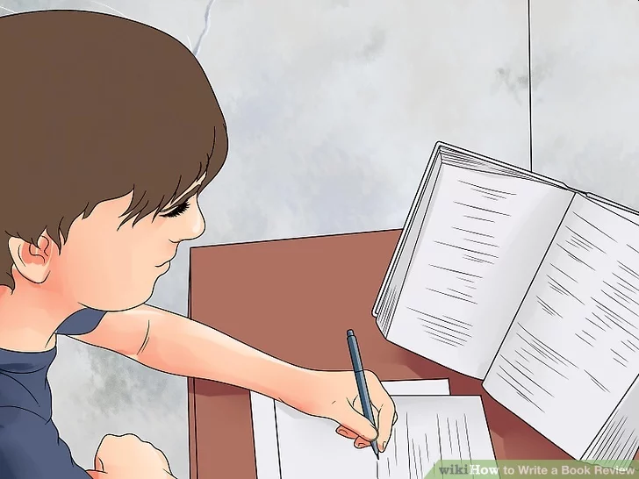
3a. Writing a Book Review
Step 1: Read the book and take notes. If possible, read the book multiple times, as repeat reads tend to lead a reader (or reviewer) to view aspects of the story, the setting and the character(s) in a new or different way.
Write down notes in a notebook to document any thoughts or impressions you have of the book as you are reading. They don't have to be organized or perfect, the idea is to brainstorm any impressions you may have of the book.
Try summarizing the major sections of the book you’re reviewing to help understand how it’s structured.

Slide 39
3a. Writing a Book Review
Step 2. Provide a summary
Have you ever watched a movie only to realize that all the good bits were already in the trailer? You don’t want the review to do that. What you do want the summary to do is reveal the genre, theme, main conflict, and main characters in the story without giving away spoilers or revealing how the story ends.
A good rule of thumb is not to mention anything that happens beyond the midpoint. Set the stage and give readers a sense of the book without explaining how the central issue is resolved.

Slide 40
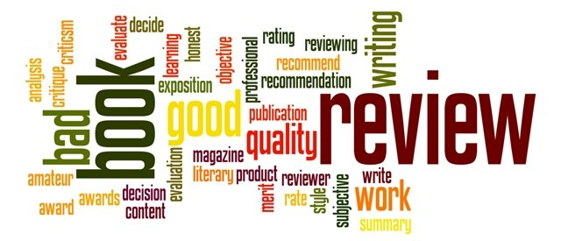
3a. Writing a Book Review
Step 3. Present your evaluation
While you should absolutely weave your own personal take of a book into the review, your evaluation shouldn’t only be based on your subjective opinion.
Along with presenting how you reacted to the story and how it affected you, you should also try to objectively critique the stronger and weaker elements of the story, and provide examples from the text to back up your points.

Slide 41
3a. Writing a Book Review
Step 3. Present your evaluation (continued)
To help you write your evaluation, you should record your reactions and thoughts as you work your way through a novel you’re planning on reviewing. Here are some questions about the book to keep in mind as you do:
Which genres does it fit into? How does it match up to your expectations of that genre?
Which point of view does it use? How does that contribute to the story?
What is the theme? What elements underscore the theme or make it apparent to the reader?
How would you describe the author’s writing style?
Does the story start with action? With exposition? Which elements are introduced to the reader in the first chapter?
Does the story have a satisfying ending? Which loose ends are tied up, and which questions are left unanswered?
Is it well-edited or are there frequent instances of spelling or grammatical errors? What about plot holes or inconsistencies within the story itself?
What emotions were you left with upon finishing the book? Does it feel well-developed or like it needs more work?
How does this book compares to other works by this author? Or to other relevant titles in the same genre/with the same themes?

Slide 42
3a. Writing a Book Review
Step 4. Give your recommendation
At the end of the day, your critique needs to answer this question: is this a book you would (or wouldn’t) recommend to other readers? You might wrap up by comparing it to other books in the same genre, or authors with similar styles, such as: “Fans of so-and-so will enjoy this book.”

Slide 43
3a. Writing a Book Review
Bonus tips for writing a book review
Remember, this isn’t a book report. If someone wants the summary of a novel, they can read the synopsis. People want book reviews for a fellow reader’s take on the book. And for that reason...
Have an opinion. Even if your opinion is totally middle-of-the-line — you didn’t hate the book but you didn’t love it either — state that clearly, and explain why.
Make your stance clear from the outset. Don’t save your opinion just for the evaluation. Weave your thoughts about the book into your summary as well, so that readers have an idea of your opinion from the outset.
Back up your points. Instead of just saying, “the prose was evocative” — show readers by providing an actual passage that displays this. Same goes for negative points — don’t simply tell readers you found the character unbelievable, share a certain (non-spoiler) scene that backs this up.
Provide the details. Don’t forget to weave the book’s information into the review: Is this one installment of a series? What types of works has the author written before? What is their background? How many pages does the book have? Who published the book? What is the book’s price?
Learn from others. One of the best ways to learn how to write a great review is to read other reviews!

Slide 44
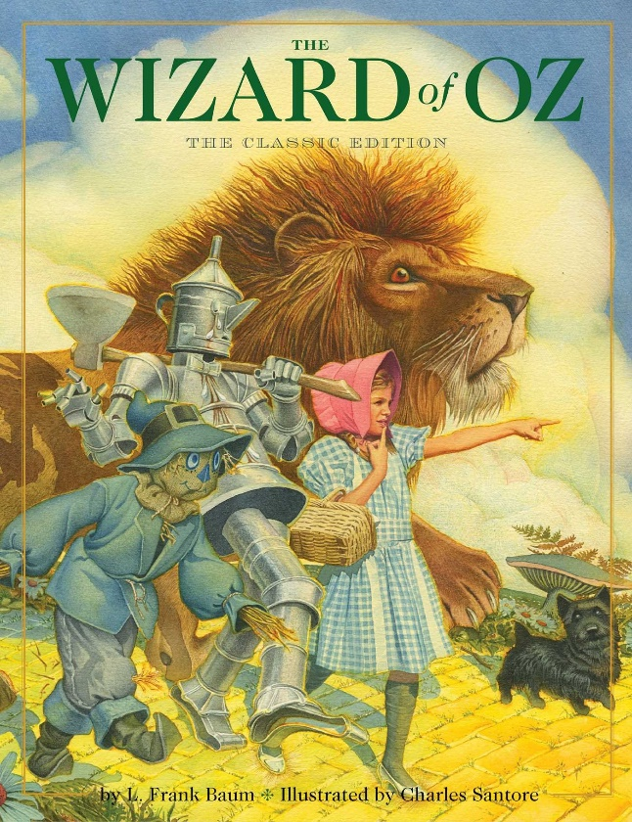
3b. Watch a Movie Based on a Book
What was the same between the book and movie? What was different? Which did you enjoy more?
Examples of movies based on books:
The Wizard of Oz (1939)
The Princess Bride (1987)
Jurassic Park (1993)
Harry Potter and the Sorcerer's Stone (2001)
Harry Potter and the Chamber of Secrets (2002)
Harry Potter and the Prisoner of Azkaban (2004)
Harry Potter and the Goblet of Fire (2005)
Harry Potter and the Order of the Phoenix (2007)
Harry Potter and the Half-Blood Prince (2009)
The Hobbit: An Unexpected Journey (2012)
The Hobbit: The Desolation Of Smaug (2013)
The Hobbit: The Battle Of The Five Armies (2014)
The Lord Of The Rings: The Fellowship Of The Ring (2001)
The Lord Of The Rings: The Two Towers (2002)
The Lord Of The Rings: The Return Of The King (2003)

Slide 45
3c. How to Give a Book Talk
Opening: Hook your audience!
Give the title and author of the book.
Read a quote from the book, ask a question of your audience, introduce the main character, vividly set the scene, or do a combination of a few of these techniques.
Summary: Briefly summarize the plot of the book.
Be sure that your summary introduces the main character, identifies the problem, and leads us toward the solution (without giving away the ending.)
Impression: Share your opinion.
How did you feel about the book?
What did you think of the author?
Would you recommend it to others?
What would you rate it?
Closing: Entice your audience.
Ask a rhetorical question, read a quote from the book, use a cliffhanger, or do a combination of these techniques.
Remember, your book talk should flow nicely, like a commercial. It should not be a giant list answering these questions.

Slide 46
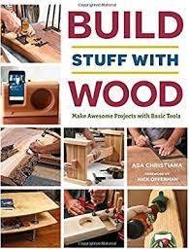
Requirement 4
Read a nonfiction book or magazine that teaches you how to do something like cooking, wood-building projects, video game design, science experiments, knot-tying, etc. With your counselor's and parent's or guardian's permission, complete a project from the book. Share your experience with your merit badge counselor. Reading a merit badge pamphlet will not count toward completing this requirement.

Slide 47
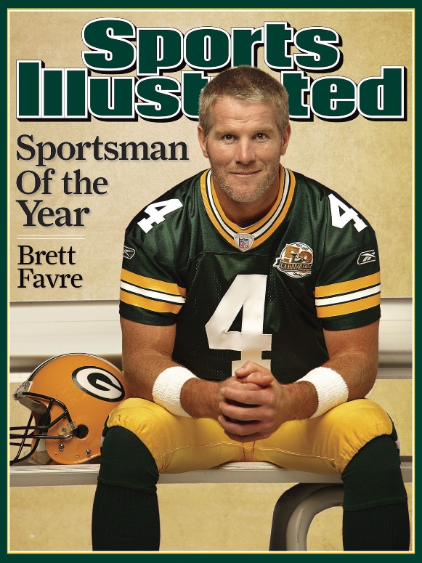
Requirement 5
Read about the world around you from any two sources: books, magazines, newspapers, the internet (with your parent's or guardian's permission), field manuals, etc. Topics may include Scouting, sports, environmental problems, politics, social issues, current events, nature, religion, etc. Discuss what you have learned with your counselor.

Slide 48
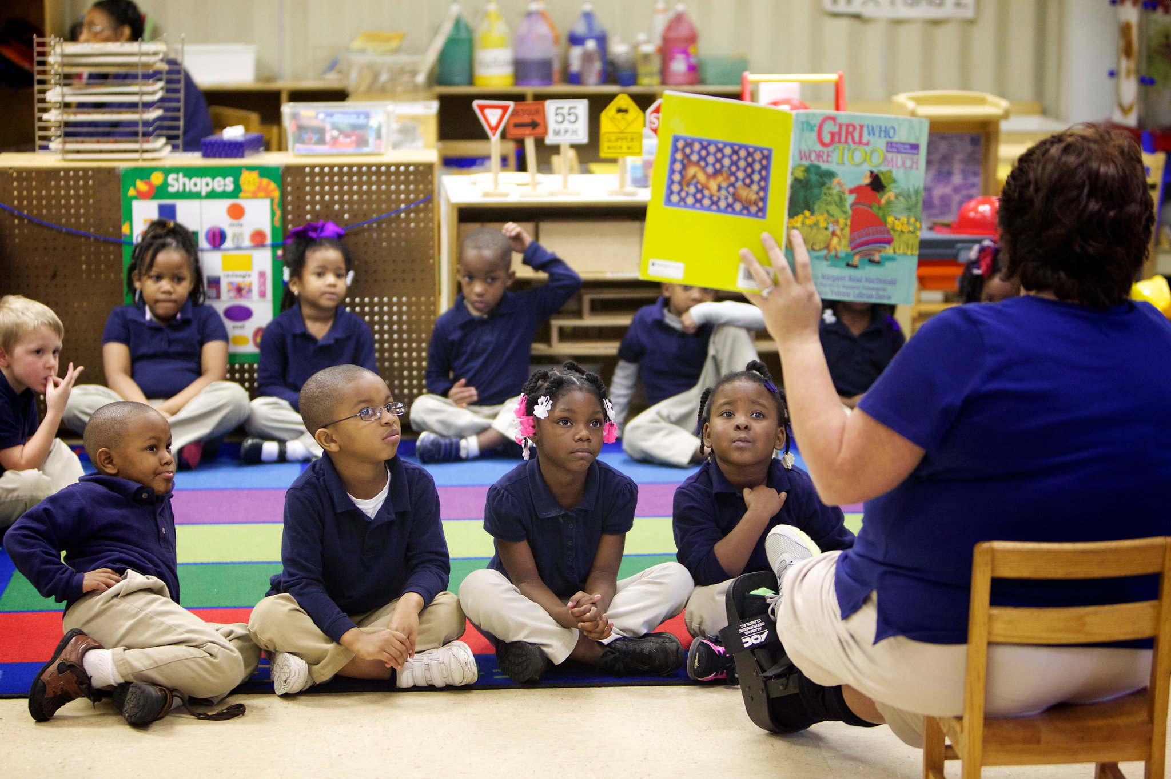
Requirement 6
With your counselor's and parent's or guardian's permission, choose ONE of the following activities and devote at least four hours of service to that activity. Discuss your participation with your counselor.
Read to a sick, blind, or homebound person in a hospital or in an extended-care facility.
Perform volunteer work at your school library or a public library.
Read stories to younger children, in a group or individually.
Organize a book swap in your troop, school, or place of worship.
Organize a book drive to collect books. Donate them to an organization in need.

